Slide 1


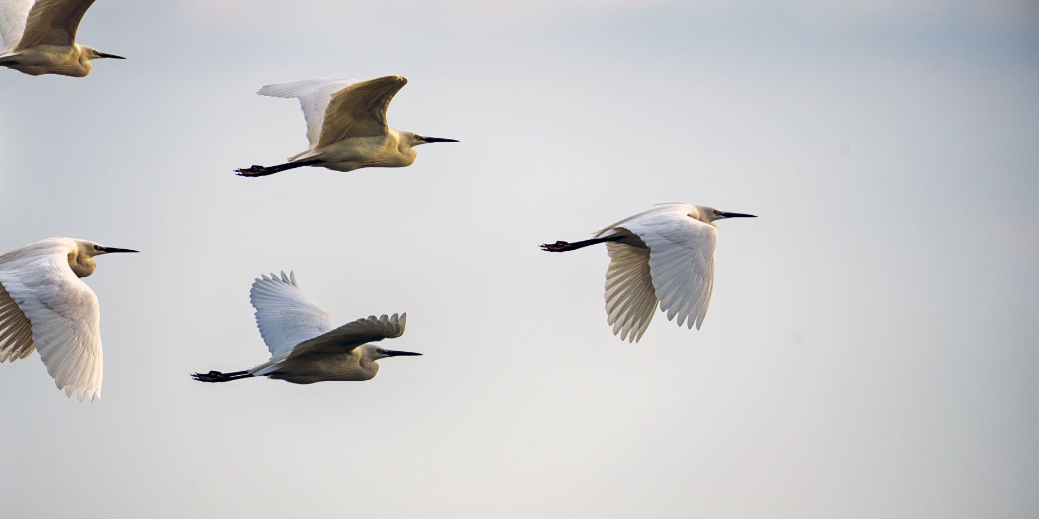


Bird Strikes Analysis on flight

Slide 2

Problem Statement
In the realm of analytics, transport and communication stand as pivotal domains. Among the various modes of transportation, air transportation holds prominence for its popularity and convenience. However, it is imperative to acknowledge the prevalent challenge of bird strikes within this sector. Bird strikes represent a significant concern, warranting meticulous attention and strategic solutions to ensure the safety and efficiency of air travel operations.
Bird strikes may occur during any phase of flight, but are most likely during the take-off, initial climb, approach and landing phases due to the greater numbers of birds in flight at lower levels. To have a closer look the following document visually depicts the data collected on Bird Strikes by FAA between 2000-2011.

Slide 3



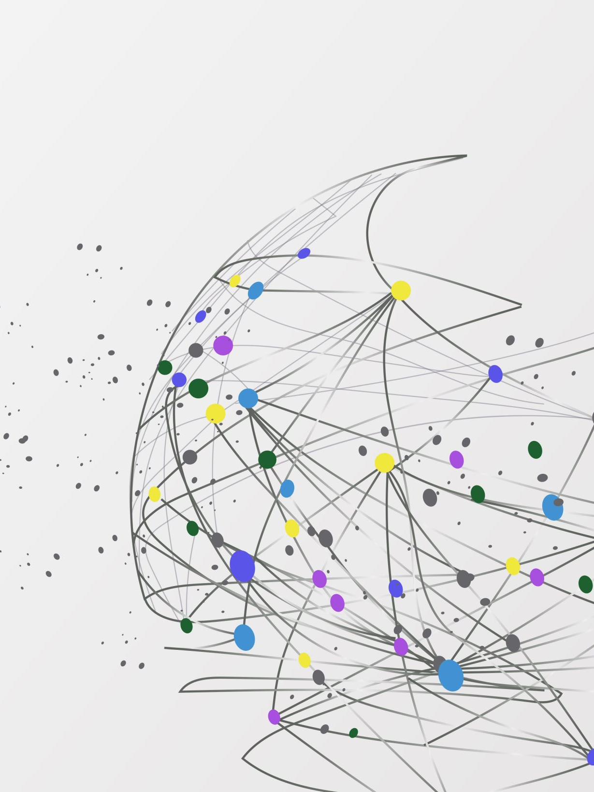
By analyzing bird strike data, I get some inside. Let's move Ahead step by step

Slide 4
Main KPIS
Airlines
Date
Total bird strike
Phase of flight
Effect on flight
Total cos

Slide 5

Case Studies
● Visuals Depicting the Number of Bird Strike
● Yearly Analysis & Bird Strikes in the US
● Top 10 US Airlines in terms of having encountered bird strikes
● Airports with most incidents of bird strikes – Top 50
● Yearly Cost Incurred due to Bird Strikes
● When do most bird strikes occur?
● Altitude of Aero planes at the time of strike
● Phase of flight at the time of the strike.
● Average Altitude of the Aero planes in different phases at the time of strike
● Effect of Bird Strikes & Impact on Flight
● Effect of Strike at Different Altitude
● Were Pilots Informed? & Prior Warning and Effect of Strike Relation

Slide 6
Key Insight
Total Bird Strikes for Prior warning (8985603) was higher than Not warning (6394103).
Prior warning accounted for 58.43% of Bird Strikes.
Precautionary Landing in Pilot warned made up 35.86% of Strikes.
Average Strikes was higher for Prior warning (369724) than No Prior warning (217510.5).
Total Strikes for Prior warning and No Prior warning diverged the most when the Effect on flight was Precautionary Landing, when Yes were 478131 higher than No.

Slide 7
Key Insight
Texas, California and New York those three states are highly bird strikes prone areas
Flights are highly damage at the altitude of <1000 ft
In United State most of the strikes happened

Slide 8
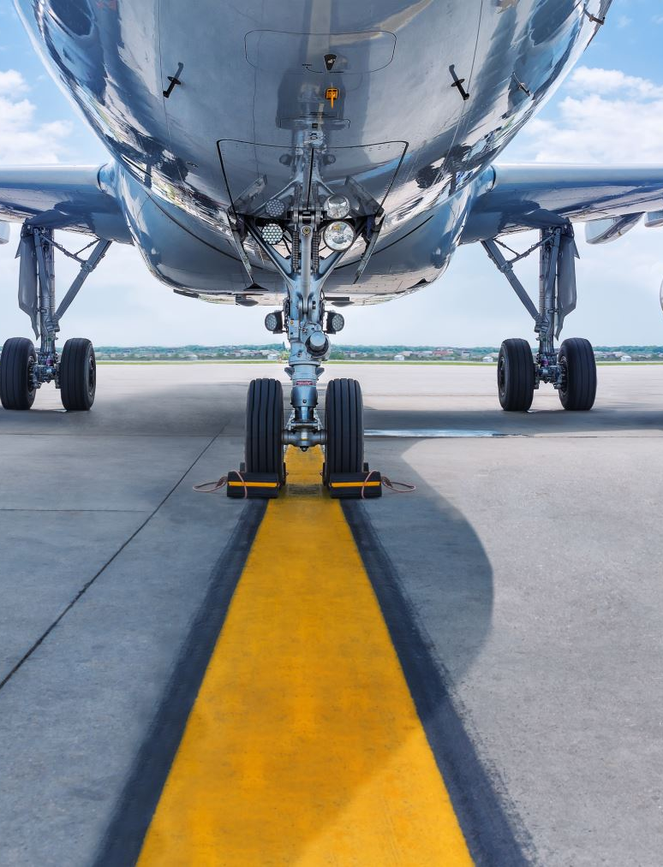
Key Insight
Approach, leading roll, take-off ran, climb are the most trandi phase according to bird strike
In US airlines Bird strikes increased by 65.68% form the year 2000 to 2011
Total cost for bird strike is increase 327.60% from the year 2000 to 2011
In US Airline Southwest Airlines is in top of total bird strike (2812026 strikes) and American airline is occupied second position of total bird strike (2404682 strikes)
In Southwest airline 23.87% of strikes happened on SACRAMENTO INTL Airport which is the top one
In American airline 65.10% of strikes happened on DALLAS/FORT WORTH INTL Airport which is the top one

Slide 9




My Design

Slide 10


